Slide 1

Algorithms, Game Theory and Blockchains
Matheus Venturyne Xavier Ferreira
Princeton University
Operations Research and Financial Engineering
March 03, 2021

Slide 2
Focus
Blockchains are mechanisms.
Challenges of design blockchains that incentivize compliance.
Analyzing existing mechanisms and propose new ones.
Not the focus:
Use cases (why does cryptocurrency have value)?
Cryptographic security.
Network security.
“Malicious attacks’’.

Slide 3
Types of blockchains
Public and permissionless.
Anyone can join, read, write.
Low scalability.
Example: Bitcoin, Ethereum, …
Public and permissioned.
Anyone can join and read but need authorization to write.
Medium scalability.
Example: Ripple.
Private.
Need permission to join, read and write.
High scalability.

Slide 4



What problem does Bitcoin solve?
Byzantine generals problem.
[LSP, 82] Requires 2/3 of generals to be loyal.
Impossible on a public, permissionless network.
Bitcoin overcomes this impossibility by introducing monetary incentives and so far, has been successful.
Notes:
The Byzantine Generals Problem [LESLIE LAMPORT, ROBERT SHOSTAK, and MARSHALL PEASE, 82]

Slide 5
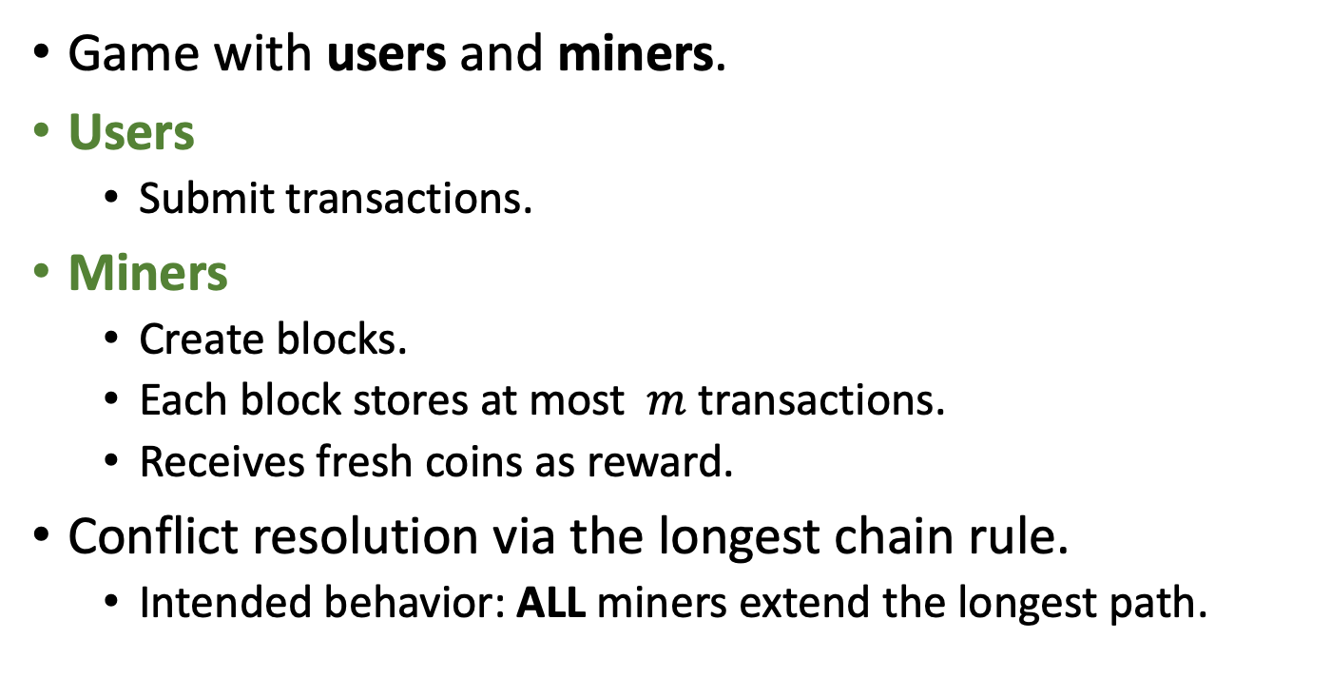
Blockchains are mechanisms
0
Alice has $10
Game with users and miners.
Users
Submit transactions.
Miners
Create blocks.
Each block stores at most $m$ transactions.
Receives fresh coins as reward.
Conflict resolution via the longest chain rule.
Intended behavior: ALL miners extend the longest path.
1
2
Alice sends $10 to Bob
Alice sends $10 to Charlie
3

Slide 6
Assumptions
0
What adversaries cannot do:
Change blocks, pointers, transaction, …
Steal someone else’s block or coins.
Takeaway: you cannot break crypto.
What adversaries can do:
Point to any block (NOT extend the longest path).
Hide a block (and broadcast it later).
Include any transactions in a block.
Takeaway: the algorithm designer cannot force miners to take any particular action.
Hidden blocks
1
2
Adversary’s block

Slide 7
Outline
Mining games.
Proof-of-work (PoW) [Eyal, Sirer 13][Sapirshtein, Sompolinsky, Zohar 16] [F, Weinberg 21].
Energy-efficient alternative: Proof-of-stake (PoS) [F, Weinberg 21].
Transaction fee auctions.
Monopolistic pricing [Lavi, Sattath, Zoha 19][Yao 20].
Dynamic posted-pricing [F, Moroz, Parkes, Stern, 21].
Mining pools.
Attacks on mining pools [Eyal 14].
Difficult adjustment algorithm (DAA)
Bitcoin cash vs Bitcoin [Noda , Okumura, Hashimoto 20]
Chaotic pure equilibrium in PoW [Fiat, Karlin, Koutsoupias, Papadimitriou, 19].

Slide 8
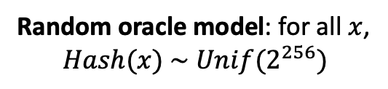
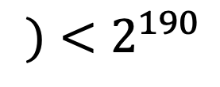
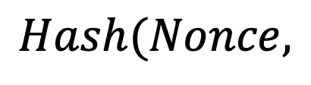
Bitcoin’s Proof-of-work
Mining tournament.
First to solve the cryptopuzzle receives the privilege to create a block.
The creator of each block currently receives 6.25 Bitcoins.
0
Random oracle model: for all $x$,
$$Hash(x) \sim Unif(2^{256})$$
$$Hash(Nonce,$$
1
$$)<2^{190}$$

Slide 9
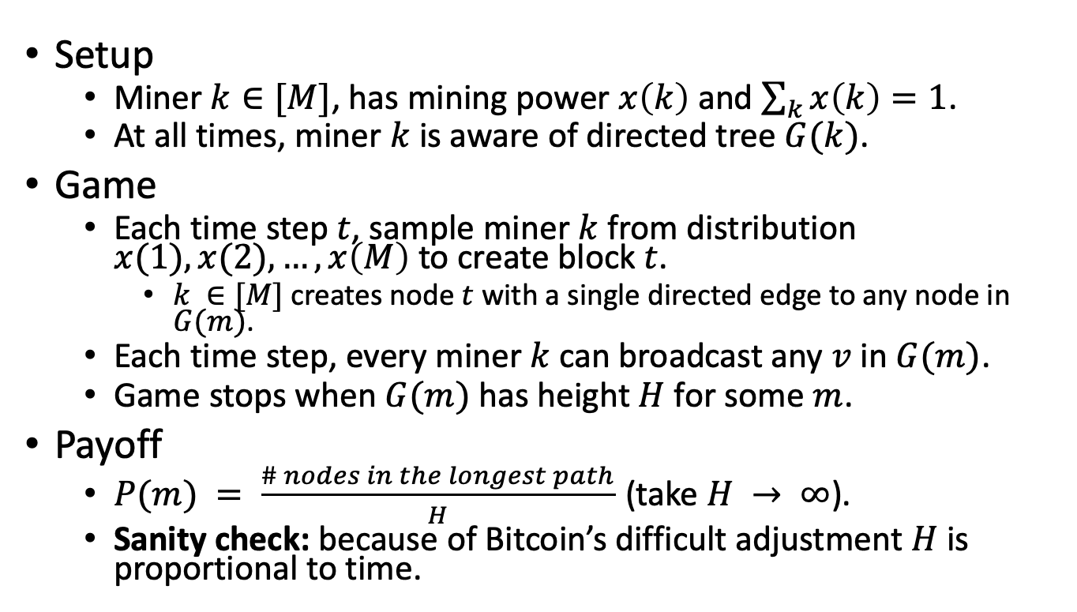
Model
Hidden
Published
Setup
Miner $k∈[M]$, has mining power $x\left(k\right)$ and $\sum_{k}{x\left(k\right)=1}$.
At all times, miner $k$ is aware of directed tree $G(k)$.
Game
Each time step $t$, sample miner $k$ from distribution $x(1), x(2), …, x\left(M\right)$ to create block $t$.
$k ∈[M]$ creates node $t$ with a single directed edge to any node in $G(m)$.
Each time step, every miner $k$ can broadcast any $v$ in $G(m)$.
Game stops when $G(m)$ has height $H$ for some $m$.
Payoff
$P(m) = \frac{\# nodes in the longest path}{H}$ (take $H → ∞$).
Sanity check: because of Bitcoin’s difficult adjustment $H$ is proportional to time.
0
1
2
4
3
5

Slide 10
Model
Hidden
Published
Setup
Miner $k∈[M]$, has mining power $x\left(k\right)$ and $\sum_{k}{x\left(k\right)=1}$.
At all times, miner $k$ is aware of directed tree $G(k)$.
Game
Each time step $t$, sample miner $k$ from distribution $x(1), x(2), …, x\left(M\right)$ to create block $t$.
$k ∈[M]$ creates node $t$ with a single directed edge to any node in $G(m)$.
Each time step, every miner $k$ can broadcast any $v$ in $G(m)$.
Game stops when $G(m)$ has height $H$ for some $m$.
Payoff
$P(m) = \frac{\# nodes in the longest path}{H}$ (take $H → ∞$).
Sanity check: because of Bitcoin’s difficult adjustment $H$ is proportional to time.
0
1
2
4
3
5

Slide 11
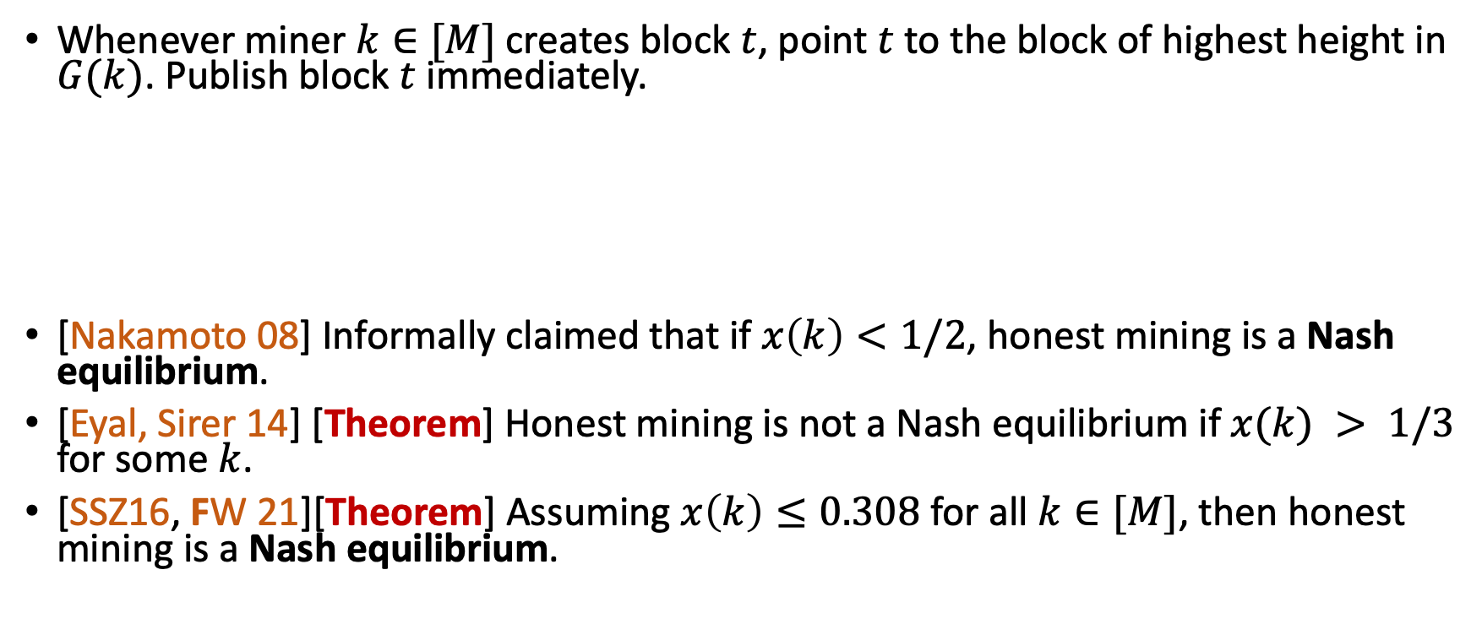
Honest mining
Whenever miner $k∈[M]$ creates block $t$, point $t$ to the block of highest height in $G(k)$. Publish block $t$ immediately.
[Nakamoto 08] Informally claimed that if $x\left(k\right)<1/2$, honest mining is a Nash equilibrium.
[Eyal, Sirer 14] [Theorem] Honest mining is not a Nash equilibrium if $x(k) > 1/3$ for some $k$.
[SSZ16, FW 21][Theorem] Assuming $x\left(k\right)≤0.308$ for all $k∈[M]$, then honest mining is a Nash equilibrium.
0
1
2

Slide 12
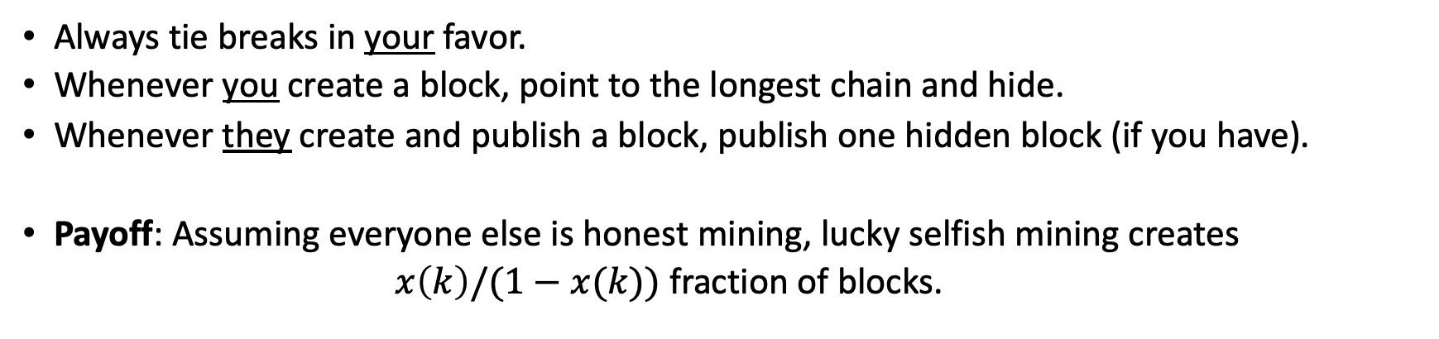
Lucky Selfish Mining [Eyal, Sirer, 13’]
Always tie breaks in your favor.
Whenever you create a block, point to the longest chain and hide.
Whenever they create and publish a block, publish one hidden block (if you have).
Payoff: Assuming everyone else is honest mining, lucky selfish mining creates
$x\left(k\right)/(1−x(k))$ fraction of blocks.
2
Hidden
Published
0
1

Slide 13
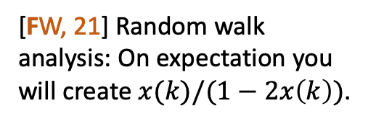
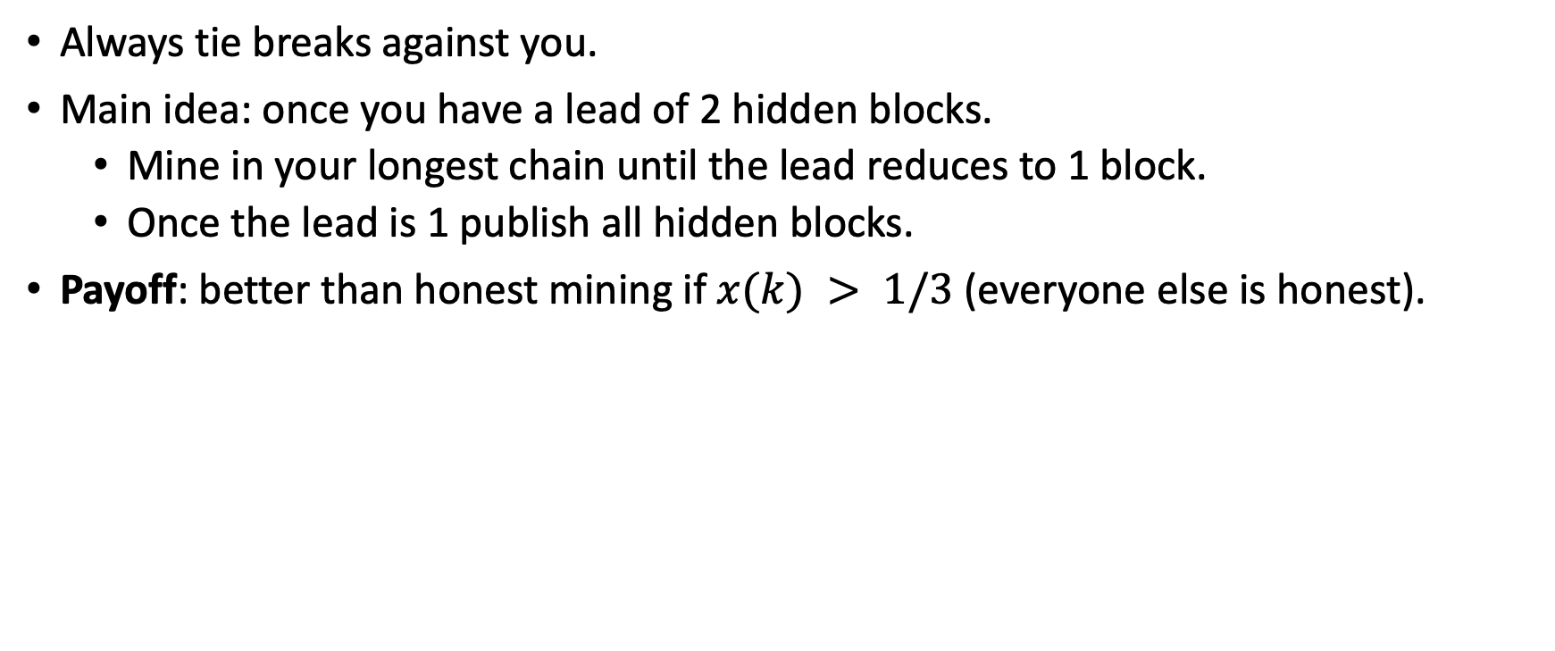
Unlucky selfish mining [Eyal, Sirer, 13’]
Always tie breaks against you.
Main idea: once you have a lead of 2 hidden blocks.
Mine in your longest chain until the lead reduces to 1 block.
Once the lead is 1 publish all hidden blocks.
Payoff: better than honest mining if $x(k) > 1/3$ (everyone else is honest).
4
5
[FW, 21] Random walk analysis: On expectation you will create $x(k)/(1−2x\left(k\right))$.
0
1
2
3

Slide 14
Outline
Mining games.
Transaction fees.
Mining pools.
Difficult Adjustment.

Slide 15

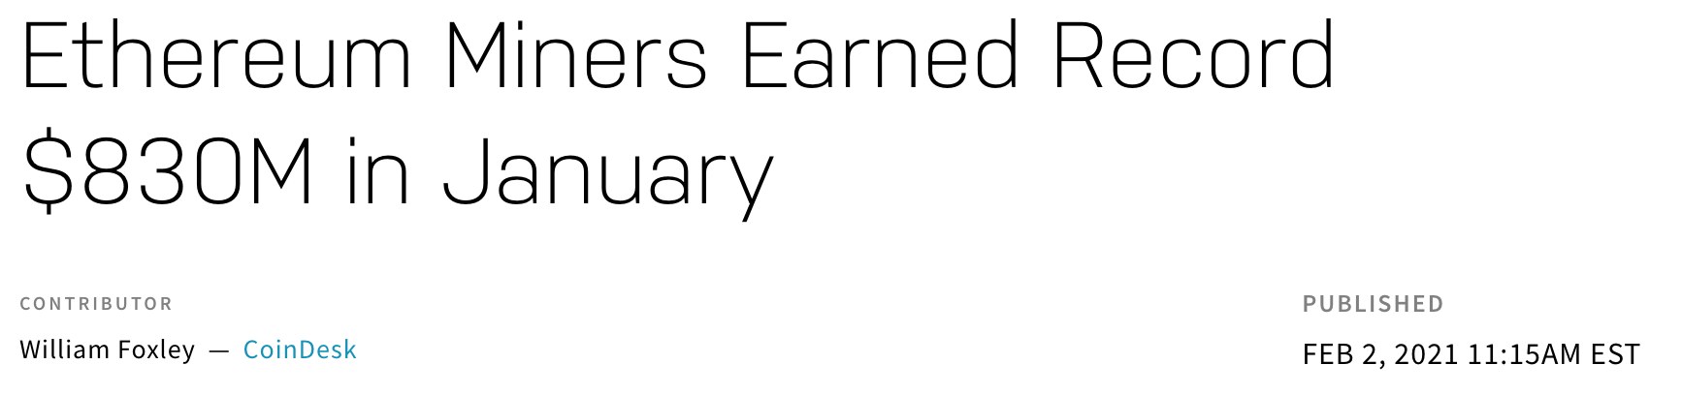
The resource allocation problem
What if there are more transactions than block space?
[Nakamoto, 08] Transactions compete in a first-price auction.
Miner that creates the block receives all the auction revenue.

Slide 16
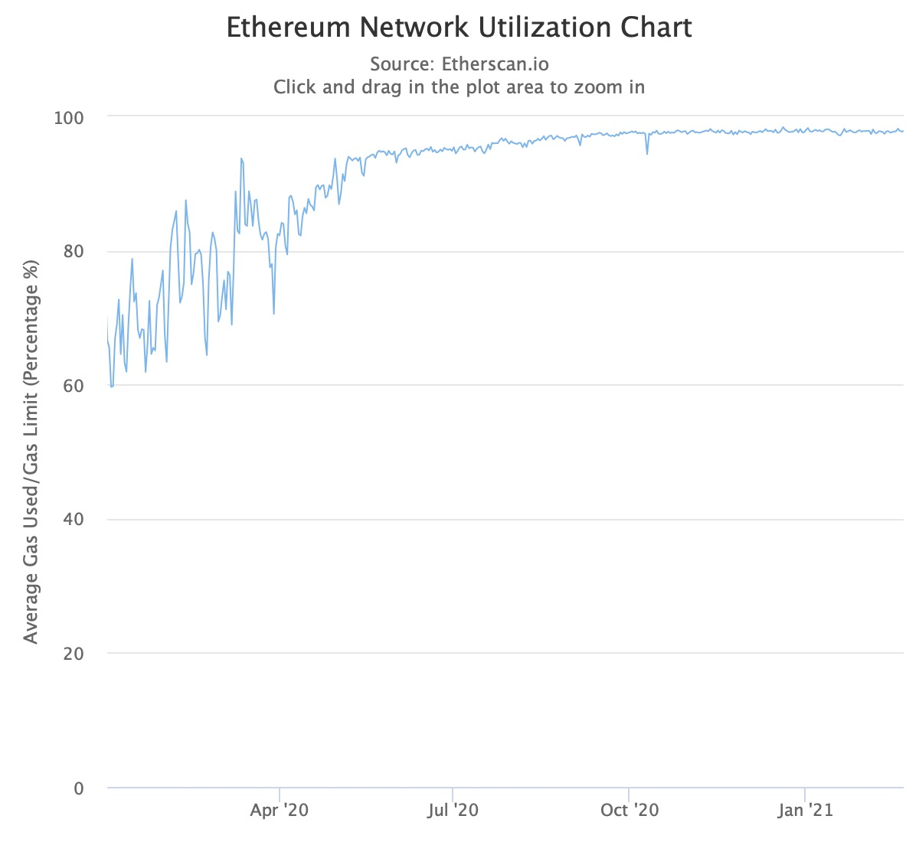
Block space is a limited resource
Ethereum reaches the saturation point

Slide 17
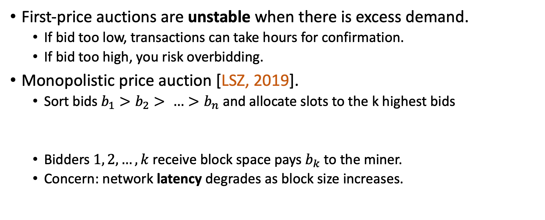
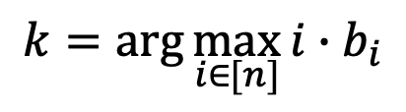
Alternative transaction auctions
First-price auctions are unstable when there is excess demand.
If bid too low, transactions can take hours for confirmation.
If bid too high, you risk overbidding.
Monopolistic price auction [LSZ, 2019].
Sort bids $b_{1}>b_{2}> …>b_{n}$ and allocate slots to the k highest bids
Bidders $1, 2, …, k$ receive block space pays $b_{k}$ to the miner.
Concern: network latency degrades as block size increases.
$$k=\arg{\max_{i∈[n]}{i∙b_{i}}}$$
Notes:
Andrew V Goldberg, Jason D Hartline, Anna R Karlin, Michael Saks, and Andrew Wright. Competitive auctions.
Ron Lavi, Or Sattath, and Aviv Zohar. 2019. Redesigning Bitcoin's fee market.

Slide 18
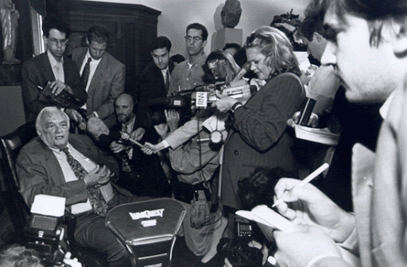
Why not use a second-price auction?
[Vickrey 61] Auctioneer collects bids privately.
Winner pays the second highest bid.
Second-Price Auction
Alice
Bob
Bid $80
Bid $20
Vickrey. Awarded the 1996 Nobel prize in economics.
Pay $20

Slide 19
What can go wrong in a public blockchain
Alice
Second-Price Auction
Bob
Bid $80
Bid $79.99
Pay $79.99

Slide 20


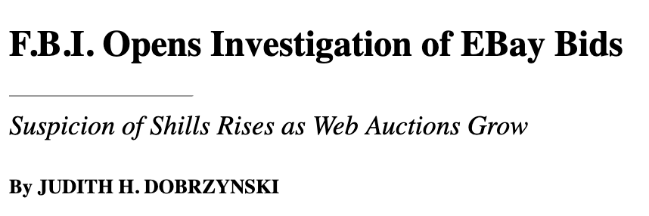
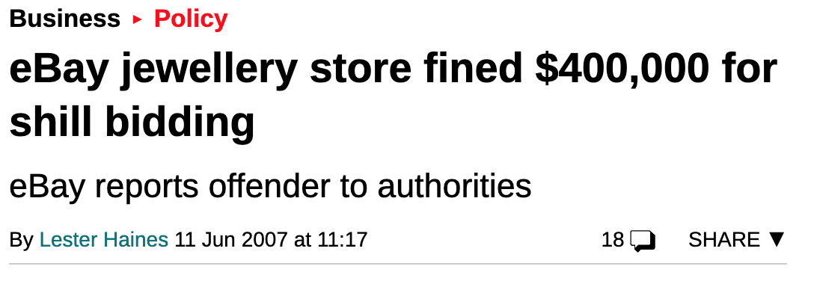

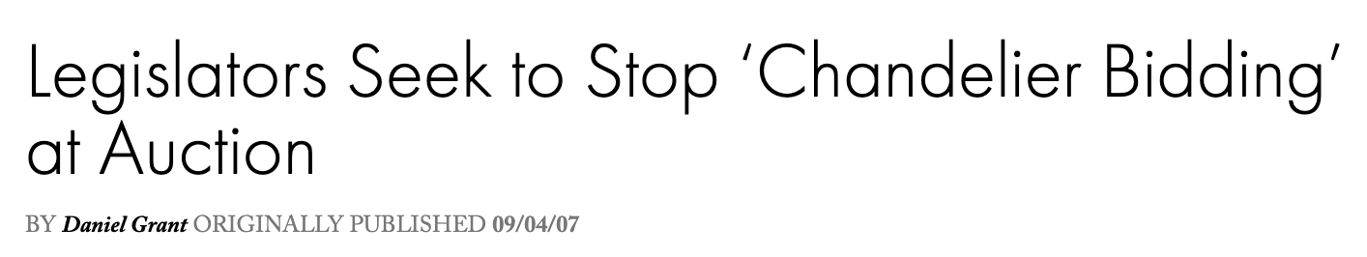
Algorithm designer as an adversary
Notes:
There is plenty of evidence that in a decentralized internet economy, the auctioneer might have incentive to not implement the promised auction. The most obvious deviation is that the auctioneer submit fake bids.
When users are concern about the integrity of the auctioneer, we need to look beyond second-price auctions.

Slide 21
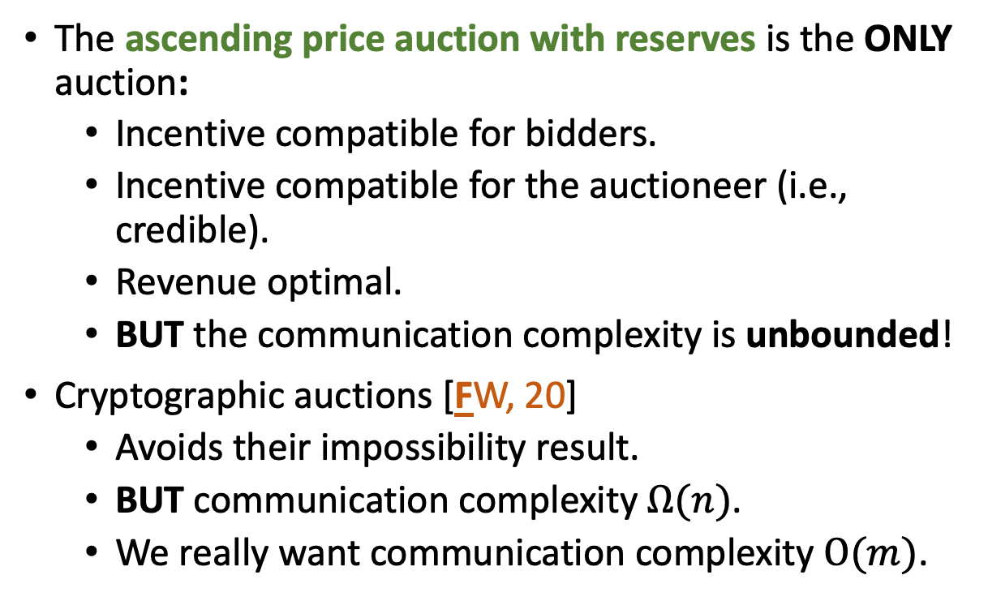
Credible Auctions [Akbarpour and Li, 20]
The ascending price auction with reserves is the ONLY auction:
Incentive compatible for bidders.
Incentive compatible for the auctioneer (i.e., credible).
Revenue optimal.
BUT the communication complexity is unbounded!
Cryptographic auctions [FW, 20]
Avoids their impossibility result.
BUT communication complexity $Ω(n)$.
We really want communication complexity $O(m)$.
Alice
Second-Price Auction
Bid $80
Pay $79

Slide 22
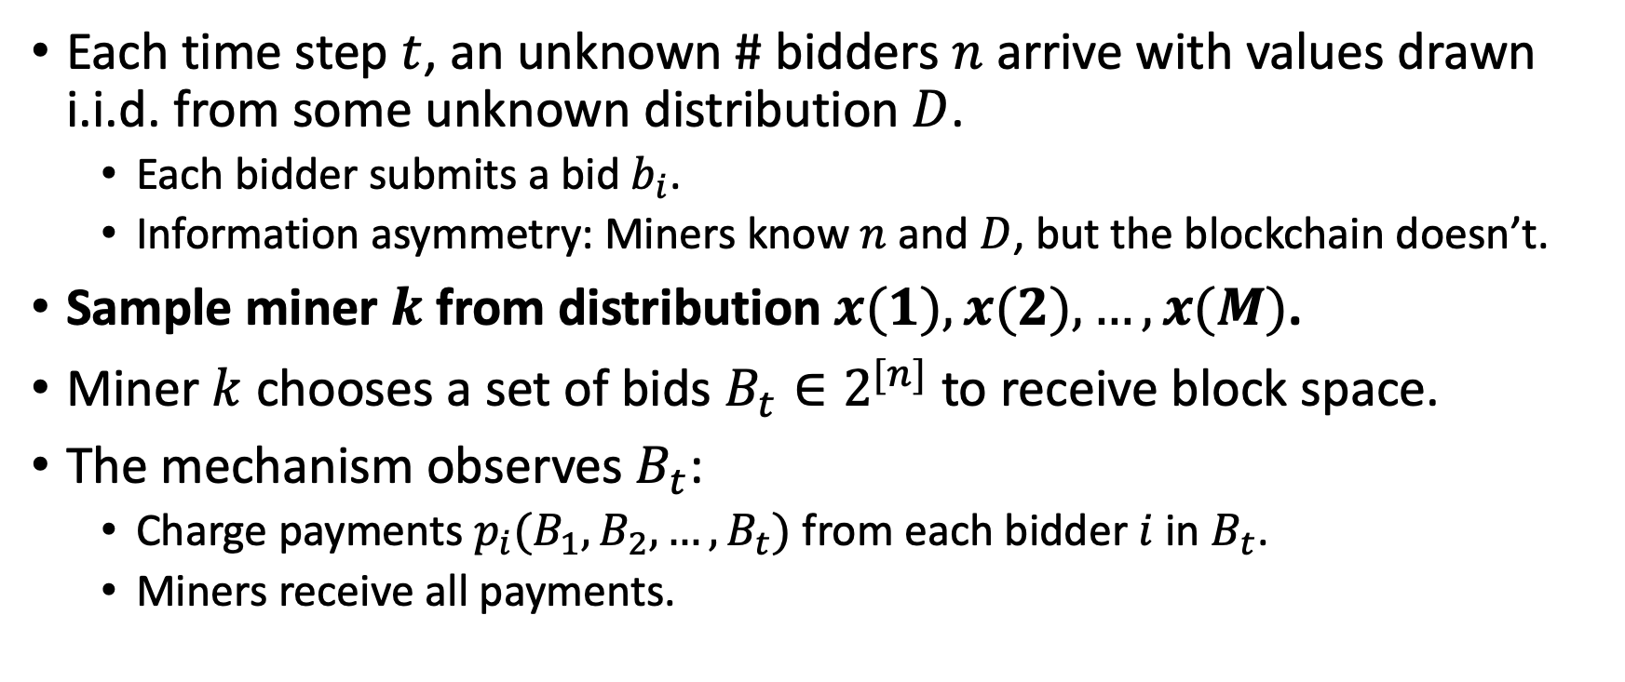
Model: Transaction fee auctions [FMPS, 21]
Each time step $t$, an unknown # bidders $n$ arrive with values drawn i.i.d. from some unknown distribution $D$.
Each bidder submits a bid $b_{i}$.
Information asymmetry: Miners know $n$ and $D$, but the blockchain doesn’t.
Sample miner $k$ from distribution $x(1), x(2), …, x(M)$.
Miner $k$ chooses a set of bids $B_{t}∈2^{[n]}$ to receive block space.
The mechanism observes $B_{t}$:
Charge payments $p_{i}(B_{1},B_{2},…, B_{t})$ from each bidder $i$ in $B_{t}$.
Miners receive all payments.

Slide 23
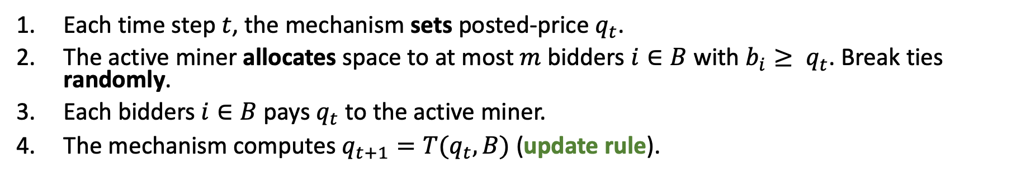
Dynamic Posted-Pricing
Each time step $t$, the mechanism sets posted-price $q_{t}$.
The active miner allocates space to at most $m$ bidders $i∈B$ with $b_{i}≥ q_{t}$. Break ties randomly.
Each bidders $i∈B$ pays $q_{t}$ to the active miner.
The mechanism computes $q_{t+1}=T(q_{t}, B)$ (update rule).
Supply of $m = 100$ blockchain slots. Distribution values a drawn from: $\operatorname{Pr}\left[v>x\right]=e^{−x}$.

Slide 24
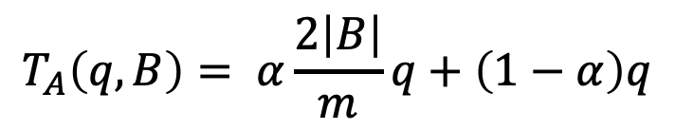
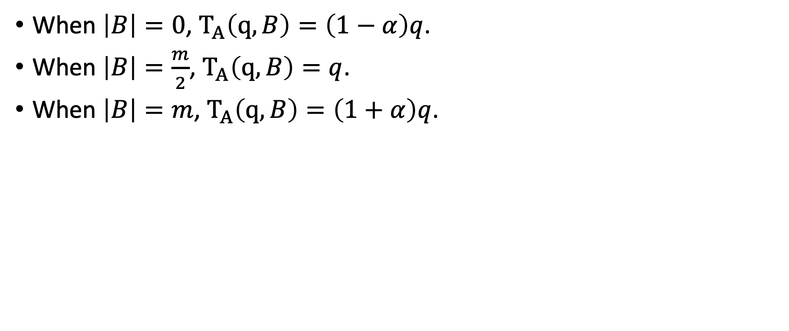
Allocation-based update rule (EIP-1559)
When $\left|B\right|=0$, $T_{A}\left(q, B\right)=\left(1−α\right)q$.
When $\left|B\right|=\frac{m}{2}$, $T_{A}\left(q, B\right)=q$.
When $\left|B\right|=m$, $T_{A}\left(q, B\right)=\left(1+α\right)q$.
$$T_{A}\left(q, B\right)= α\frac{2\left|B\right|}{m}q+\left(1−α\right)q$$
Hence, the goal is to keep utilization at $\frac{m}{2}$.

Slide 25
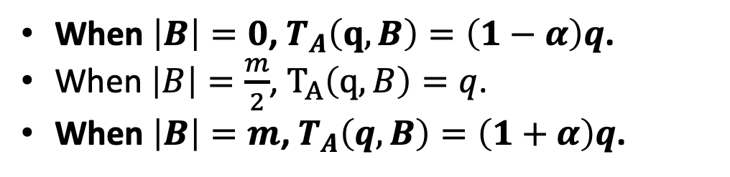
Not always stable
Supply of $m = 100$. Distribution values a drawn from: $\operatorname{Pr}\left[v=100\right]=1$.
When $\left|B\right|=0$, $T_{A}\left(q, B\right)=\left(1−α\right)q$.
When $\left|B\right|=\frac{m}{2}$, $T_{A}\left(q, B\right)=q$.
When $\left|B\right|=m$, $T_{A}\left(q, B\right)=\left(1+α\right)q$.

Slide 26
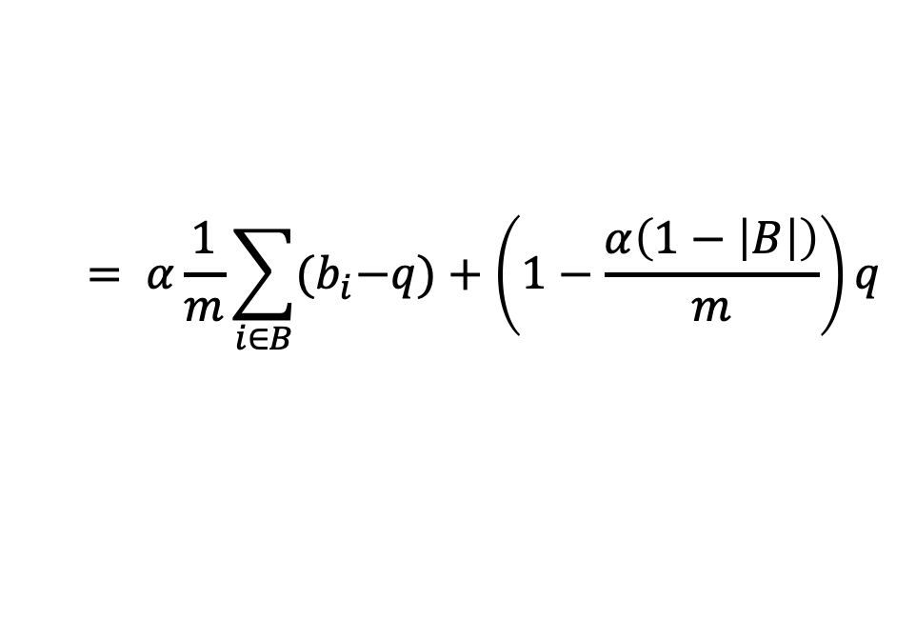
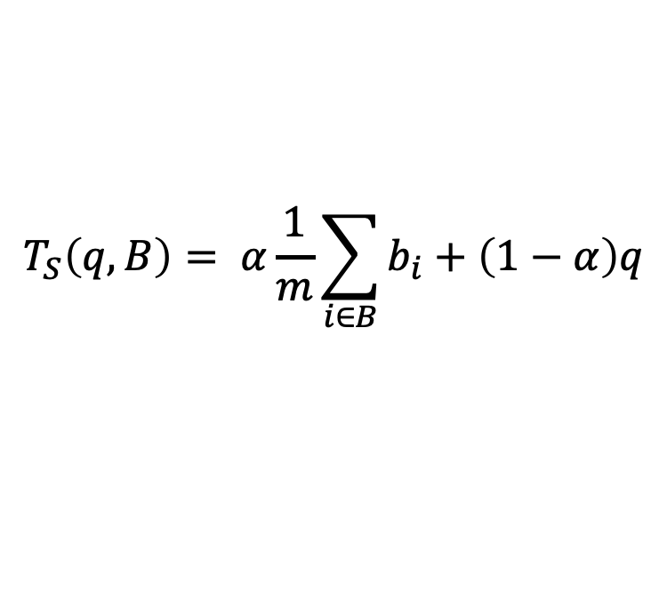
Strawman update rule
Supply of $m = 100$. Distribution values a drawn from: $\operatorname{Pr}\left[v=100\right]=1$.
$$T_{S}\left(q, B\right)= α\frac{1}{m}\sum_{i∈B}{b_{i}}+\left(1−α\right)q$$
$$= α\frac{1}{m}\sum_{i∈B}{{(b}_{i}−q)}+\left(1−\frac{α\left(1−\left|B\right|\right)}{m}\right)q$$
Welfare
Surplus

Slide 27
High variance under heavy-tailed distributions
Supply of $m = 100$. Distribution values a drawn from: $\operatorname{Pr}\left[v>x\right]=\frac{1}{x}$.
$$T_{S}\left(q, B\right)= α\frac{1}{m}\sum_{i∈B}{b_{i}}+\left(1−α\right)q$$
$$= α\frac{1}{m}\sum_{i∈B}{{(b}_{i}−q)}+\left(1−\frac{α\left(1−\left|B\right|\right)}{m}\right)q$$
Welfare
Surplus

Slide 28
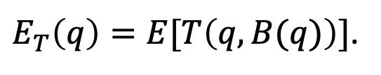
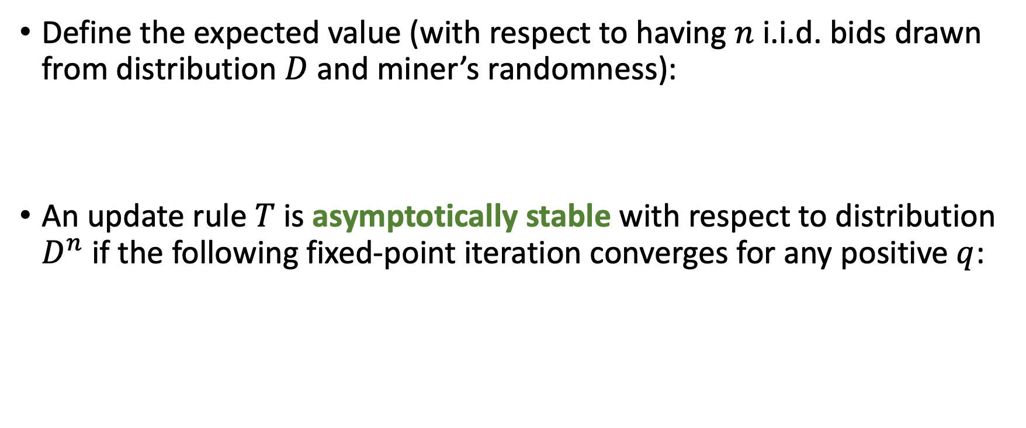
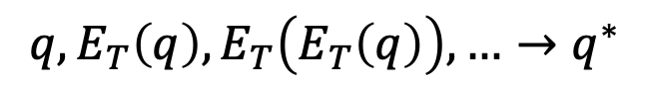
Stability
Define the expected value (with respect to having $n$ i.i.d. bids drawn from distribution $D$ and miner’s randomness):
An update rule $T$ is asymptotically stable with respect to distribution $D^{n}$ if the following fixed-point iteration converges for any positive $q$:
$E_{T}\left(q\right)=E[T\left(q, B(q)\right)]$.
$$q, E_{T}\left(q\right), E_{T}\left(E_{T}\left(q\right)\right), …→q^{∗}$$
Equilibrium price

Slide 29

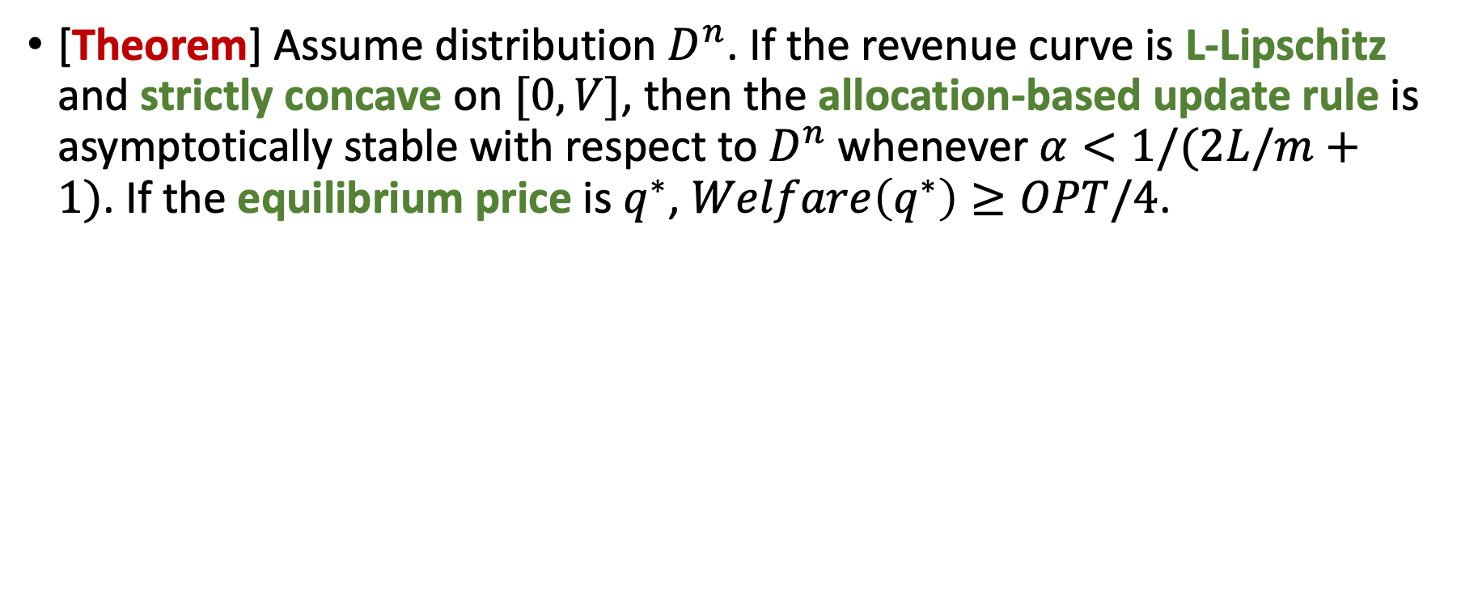
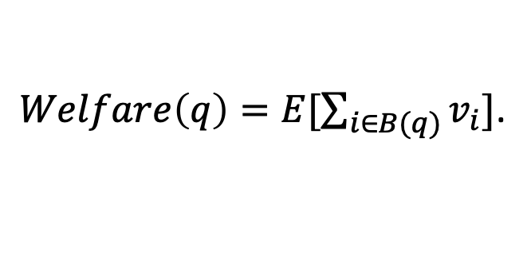
Stability of allocation-based update rule
[Theorem] Assume distribution $D^{n}$. If the revenue curve is L-Lipschitz and strictly concave on $[0, V]$, then the allocation-based update rule is asymptotically stable with respect to $D^{n}$whenever $α<1/(2L/m+1)$. If the equilibrium price is $q^{∗}$, $Welfare\left(q^{∗}\right)≥OPT/4$.
$$E_{T_{A}}\left(q\right)=\frac{2α}{m}E[q\left|B\right|]+\left(1−α\right)q$$
Expected revenue with posted-price q
$Welfare\left(q\right)=E[\sum_{i∈B(q)}{v_{i}}]$.

Slide 30
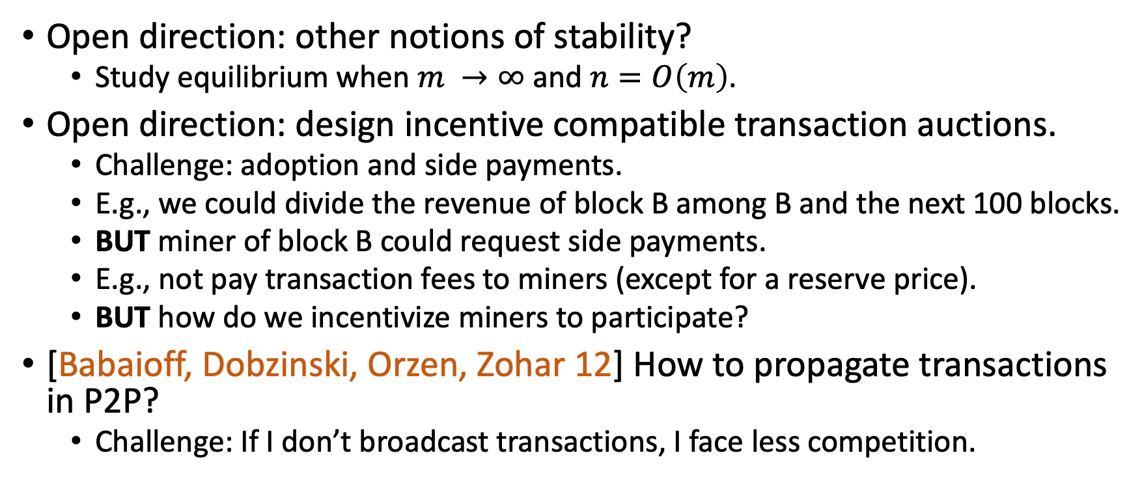
Summary: Transaction fees
Open direction: other notions of stability?
Study equilibrium when $m →∞$ and $n=O\left(m\right)$.
Open direction: design incentive compatible transaction auctions.
Challenge: adoption and side payments.
E.g., we could divide the revenue of block B among B and the next 100 blocks.
BUT miner of block B could request side payments.
E.g., not pay transaction fees to miners (except for a reserve price).
BUT how do we incentivize miners to participate?
[Babaioff, Dobzinski, Orzen, Zohar 12] How to propagate transactions in P2P?
Challenge: If I don’t broadcast transactions, I face less competition.

Slide 31
Outline
Mining games.
Transaction fees.
Mining pools.
Difficult Adjustment.

Slide 32
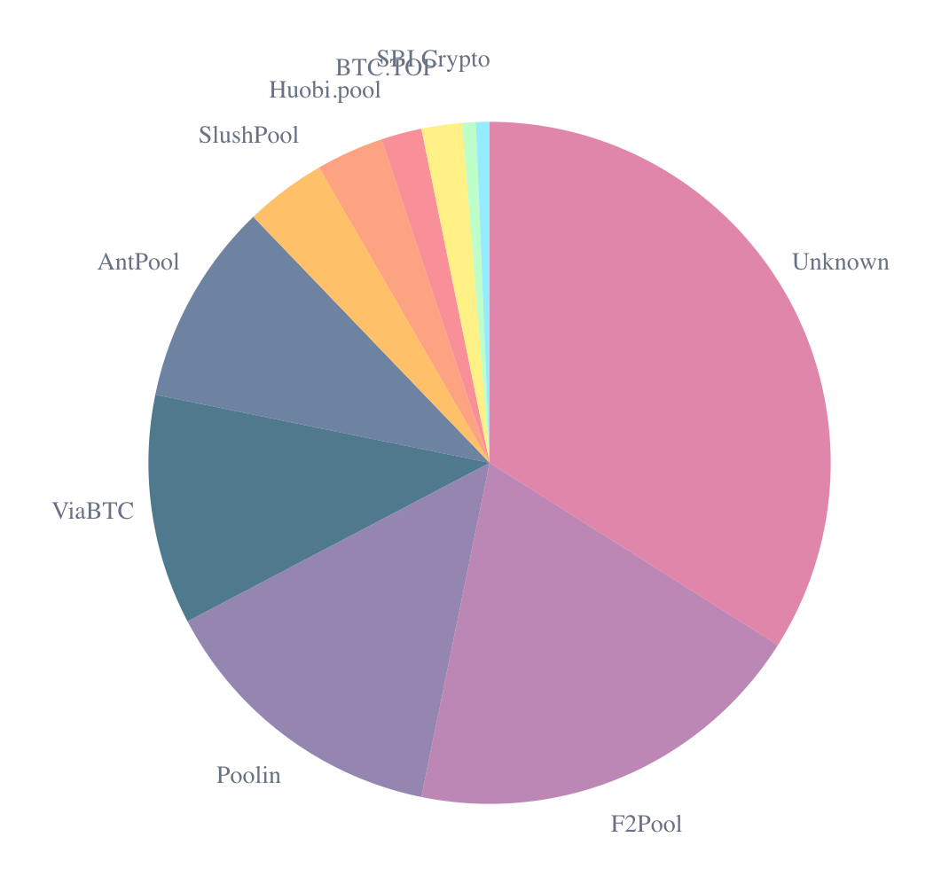
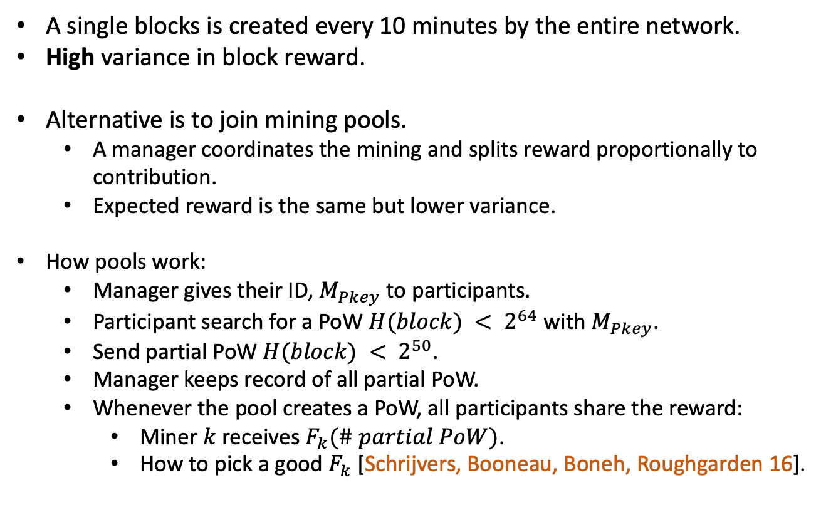
Mining Pools
Based on ACM EC tutorial from 2018 by Matt Weinberg
A single blocks is created every 10 minutes by the entire network.
High variance in block reward.
Alternative is to join mining pools.
A manager coordinates the mining and splits reward proportionally to contribution.
Expected reward is the same but lower variance.
How pools work:
Manager gives their ID, $M_{Pkey}$ to participants.
Participant search for a PoW $H(block) < 2^{64}$ with $M_{Pkey}$.
Send partial PoW $H(block) < 2^{50}$.
Manager keeps record of all partial PoW.
Whenever the pool creates a PoW, all participants share the reward:
Miner $k$ receives $F_{k}(\# partial PoW)$.
How to pick a good $F_{k}$ [Schrijvers, Booneau, Boneh, Roughgarden 16].
Source: blockchain.com

Slide 33
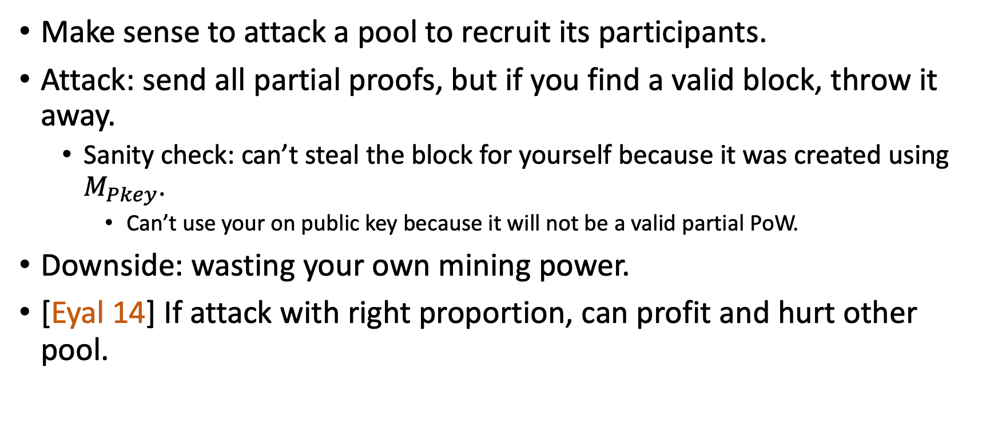
Folklore knowledge
Make sense to attack a pool to recruit its participants.
Attack: send all partial proofs, but if you find a valid block, throw it away.
Sanity check: can’t steal the block for yourself because it was created using $M_{Pkey}$.
Can’t use your on public key because it will not be a valid partial PoW.
Downside: wasting your own mining power.
[Eyal 14] If attack with right proportion, can profit and hurt other pool.

Slide 34
Mining pool infiltration attack
Two pools, A and B, each with 50% of mining power.
Pool A attacks Pool B, with 25% of total mining power.
Pool A gets 33% of Pool B’s reward, and 100% of Pool A’s rewards.
Pool A finds 33% (= 25/75) of valid pools.
Pool B finds 66% (= 50/75) of valid blocks.
Pool A gets 1/3 + 1/3 2/3 = 5/9 of the total reward.
Mining Power
Pool B rewards
Pool A rewards
Effective Mining Power

Slide 35
Summary: Mining pools
Mining pools increase centralization.
[Cong He Li, 18] But lower risk attracts more miners to the game.
[Miller, Kosba, Katz, Shi 14] There is clever solutions that would kill mining pools.
These solutions were not adopted by major cryptocurrencies.
Open directions: understand the economics of mining pools.
E.g. economic valued added (reduced risk) versus subtracted (centralization).

Slide 36
Outline
Mining games.
Transaction fees.
Mining pools.
Difficult Adjustment.

Slide 37
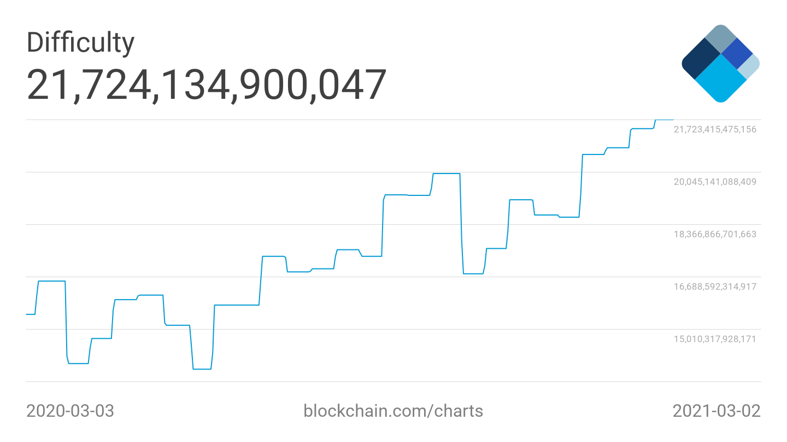
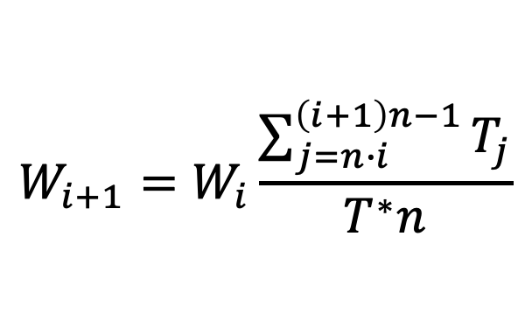
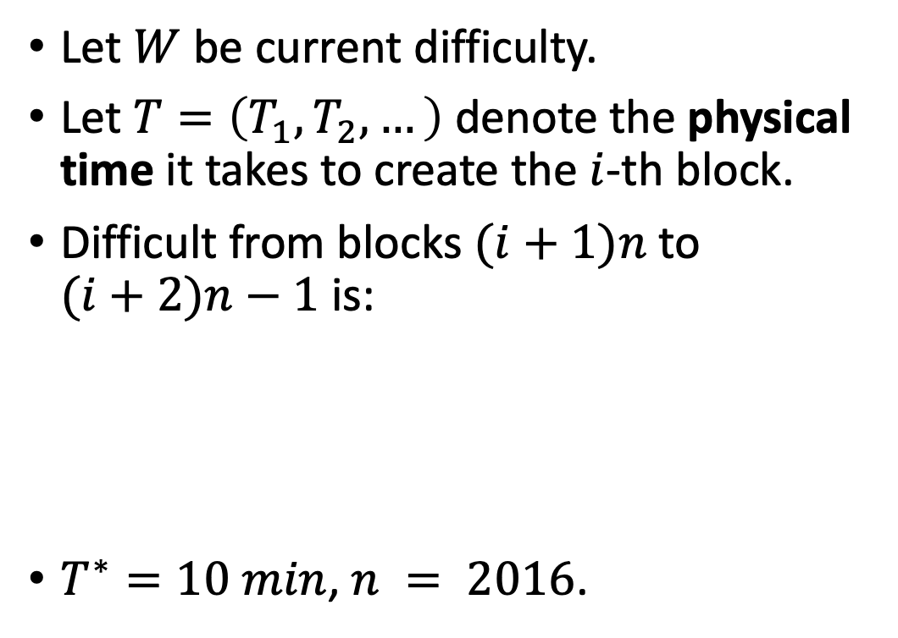
Bitcoin - Difficult Adjustment Algorithm (DAA)
Let $W$ be current difficulty.
Let $T=\left(T_{1},T_{2},…\right)$ denote the physical time it takes to create the $i$-th block.
Difficult from blocks $(i+1)n$ to $(i+2)n−1$ is:
$T^{∗}=10 min$, $n = 2016$.
$$W_{i+1}=W_{i}\frac{\sum_{j=n∙i}^{\left(i+1\right)n−1}{T_{j}}}{T^{∗}n}$$

Slide 38
Bitcoin cash DAA
Bitcoin cash was a hard fork on Bitcoin intended to increase block sizes.
Uses a slide window of size 128 as its DAA.
[NOH 20] Compares the stability of Bitcoin DAA and Bitcoin cash DAA.
In practice, Bitcoin cash DAA appears to be more vulnerable to manipulation.
[FKKP] If miners have flexibility to change the difficult and there is too many miners, the only pure equilibriums are chaotic.

Slide 39

Final remarks

Slide 40
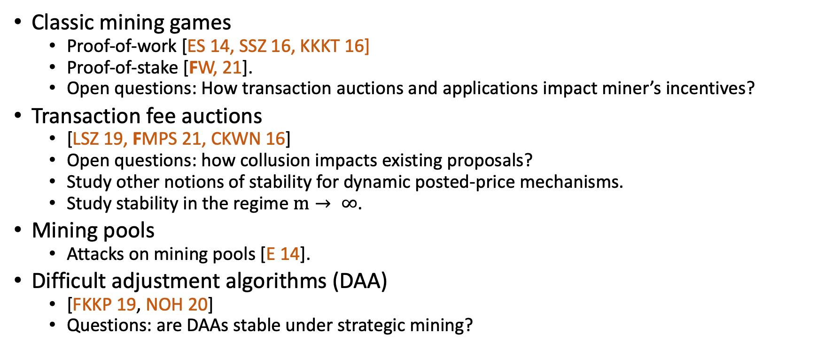
Summary
Classic mining games
Proof-of-work [ES 14, SSZ 16, KKKT 16]
Proof-of-stake [FW, 21].
Open questions: How transaction auctions and applications impact miner’s incentives?
Transaction fee auctions
[LSZ 19, FMPS 21, CKWN 16]
Open questions: how collusion impacts existing proposals?
Study other notions of stability for dynamic posted-price mechanisms.
Study stability in the regime $m→ ∞$.
Mining pools
Attacks on mining pools [E 14].
Difficult adjustment algorithms (DAA)
[FKKP 19, NOH 20]
Questions: are DAAs stable under strategic mining?

Slide 41
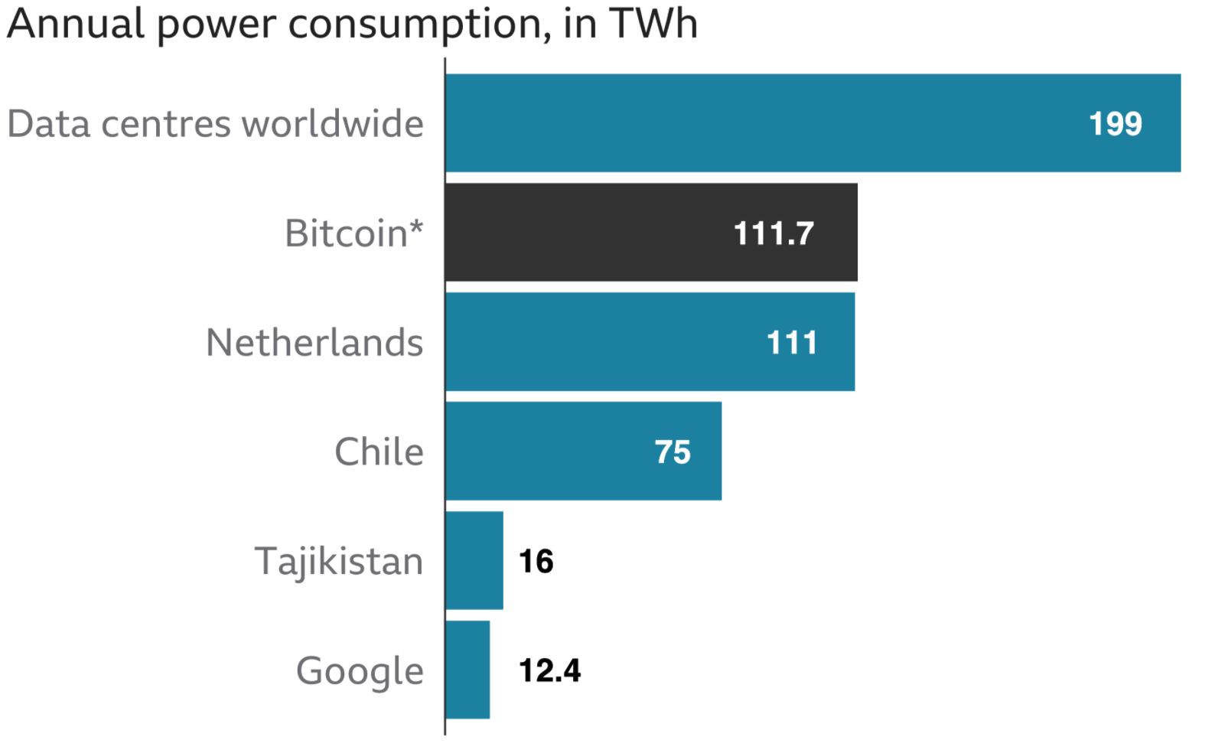
Environmental cost of Bitcoin
Bitcoin’s consensus algorithm is based on proof-of-work.
Energy intensive yet can only process 7 transactions per second.
Data centers worldwide
Source: BBC News. January 2021.
Notes:
Visa can process 65000 transactions per second

Slide 42
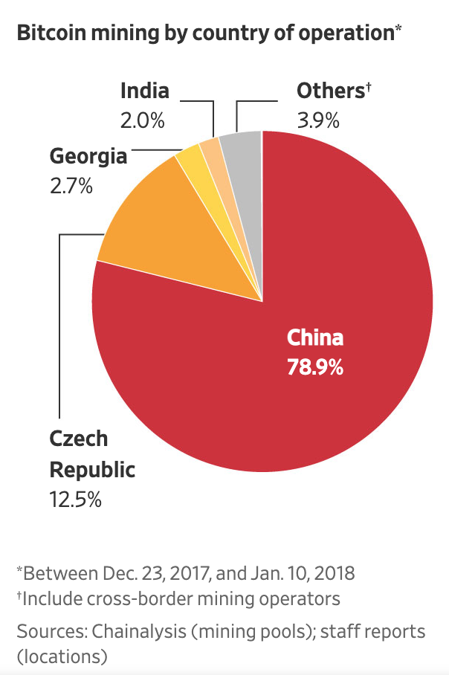
Mining centralization in PoW
Profitability of PoW mining varies by geographic region.
Energy and hardware cost.
[Arnosti, Weinberg, 18] In equilibrium:
If a miner has 20% lower cost than other miners, then she will control at least 20% of the mining power.
Economics of scale also generates high centralization.

Slide 43
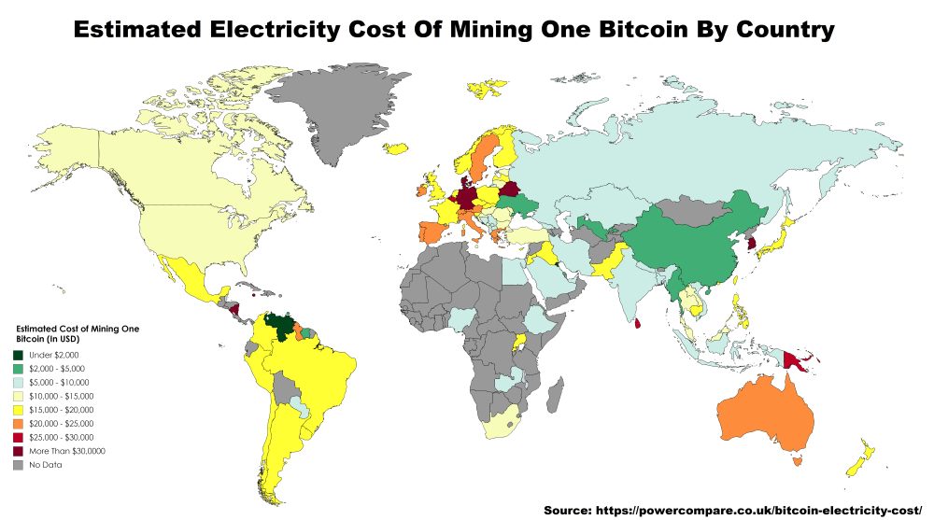

Slide 44
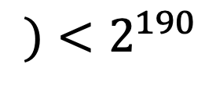
Beyond Proof-of-Work
Proof-of-work (PoW) is energy intensive
Mining election: cryptopuzzles (One CPU cycle gets One vote).
Proof-of-stake (PoS) is an energy friendly alternative.
Mining election: sample a uniformly random coin (One coin gest One vote).
Proof-of-stake Mining games [F, Weinberg, 21]
0
Takeaway: Cryptopuzzles are a very good source of pseudo-randomness.
$$Hash(Nonce,$$
1
$$)<2^{190}$$

Slide 45
References: Mining games
Majority is not enough: Bitcoin mining is vulnerable [ES 13].
Proof-of-stake mining games with perfect randomness [FW 21].
Optimal selfish mining strategies in Bitcoin [SSZ 16].

Slide 46
References: Mining pools
The miner’s dilemma [E14].
Incentive compatibility of bitcoin mining pool reward functions [SBBR 17]

Slide 47
References: Transaction fee auctions
Credible auctions: A trilemma [AL 20].
On the instability of Bitcoin without the block reward [CKWN 16].
Credible, truthful, and two-round optimal auctions via cryptographic commitments [FW 20].
Dynamic posted-pricing mechanisms as a blockchain transaction fee mechanism [FMPS 21].
Redesigning Bitcoin’s fee market [LSZ 19].
An incentive analysis of some bitcoin fee mechanisms [Y 20].
On Bitcoin and red balloons [BDOZ 11].

Slide 48
References: Others
Bitcoin: a natural oligopoly [AW 18].
Energy equilibria in proof-of-work [FKKP 19].
The byzantine generals problem [LSP, 82].
An economic analysis of difficulty adjustment algorithms in proof-of-work blockchain systems [NOH 20].

